Slide 1
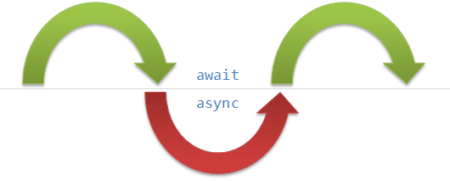
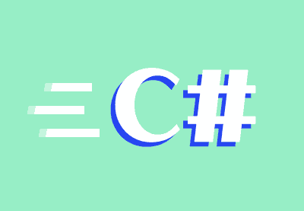
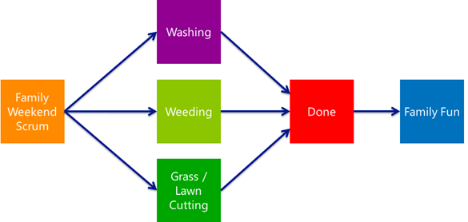
Asynchronous Programming in C#
"Synchronous" vs. Asynchronous programming, Tasks, C# 4.5 features async and await
Windows Applications for Mobile
Telerik Software Academy
http://academy.telerik.com

Slide 2
Table of Contents
Current Sequential Programming Problems
CPU-demanding tasks, Resource access
Asynchronous Programming
Benefits, Difficulties
Parallel Processing and Concurrency in .NET
Threading, Tasks
Data Parallelism
Using the Tasks.Parallel Class and PLINQ
Exceptions is parallel loops

Slide 3
Table of Contents (2)
Race Conditions, Locking, Deadlocks and the Interlocked class
Concurrent Collections
Task Parallelism and TAP
Task Overview
Creating and Running Tasks
Exceptions in Tasks
Using async and await with Tasks

Slide 4
Several things off the bat:
Asynchronous/Parallel/Concurrent will be synonyms (unless explicitly stated) when used in programming terms for:
Code built to be able to run in different threads
Will be using the words "Sequential" and "Synchronous" (in programming terms):
As the opposite of "Asynchronous" / "Parallel" / "Concurrent" programming
"Synchronous" is sort of tricky, as in other contexts it could mean parallel (i.e. synchronized swimming)

Slide 5
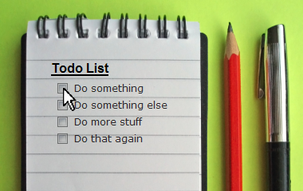
Synchronous Programming

Slide 6
Synchronous Programming
Executing program components sequentially
i.e. "Sequential programming"
Actions happen one after another
Uses a single thread of a single process
Components wait for previous ones to finish
Program resources are accessible at all points
Process
Load file
Select cypher
Encrypt file with cypher
Save
List encrypted & cyphers

Slide 7

Synchronous Programming Problems
If one component blocks, entire program blocks
UI may become unresponsive
No utilization of multi-core systems
CPU demanding tasks delay execution of all other tasks
Accessing resources blocks entire program
Especially problematic with web resources

Slide 8
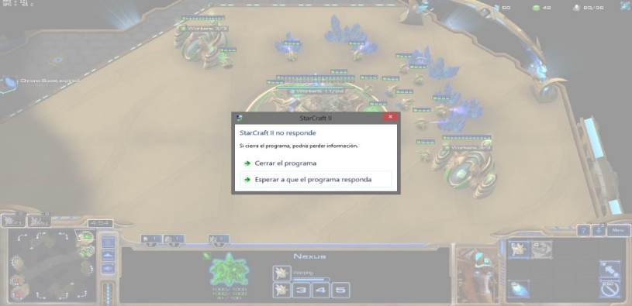
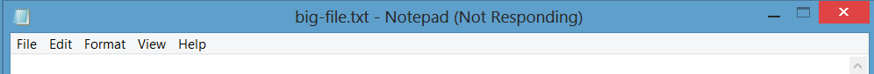
Synchronous Programming Problems
Resources
may be large
may be web-based
may be both
Slow connections mean slow loading
Server may hang and delay the response, blocking the process
UI blocks, stops responding, even if the program is working

Slide 9
Resource Access Problems
Live Demo

Slide 10
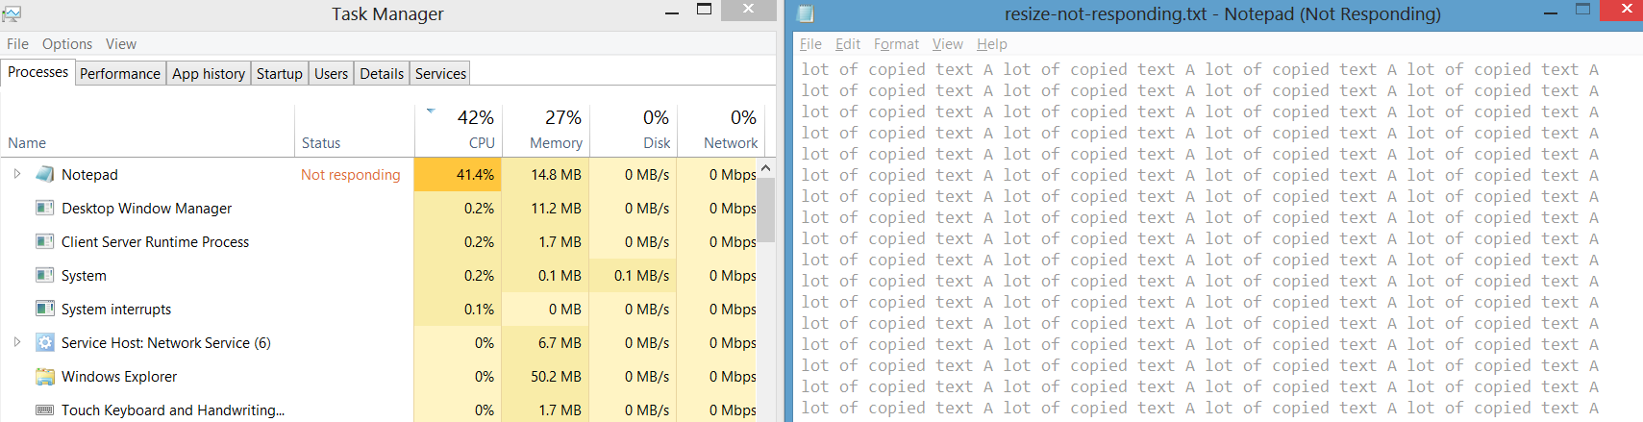
Synchronous Programming Problems
CPU-demanding problems freeze the program
Program stops responding
Some CPU-demanding tasks are many smaller, independent tasks
Must sequentially go through them

Slide 11
CPU-demanding Tasks Problems
Live Demo

Slide 12
Async Programming
Utilizing new improvements in hardware

Slide 13

Asynchronous Programming
Program components can execute in parallel
Some actions run alongside other actions
Slow actions happen in separate threads
Process
Scan sound for "Cortana" voice command
Save follow-up command to file
Upload sound files to cloud for processing
Wait for notification with processed commands and execute
Send user's personal conversations to NSA

Slide 14
Asynchronous Code Benefits
If a components blocks, others still run
Until they need a resource from blocked one
UI runs separately
Always responsive
Utilization of multi-core systems
Each core executes one or several threads
Resource access runs on "background" threads
CPU-heavy tasks on "background" threads

Slide 15
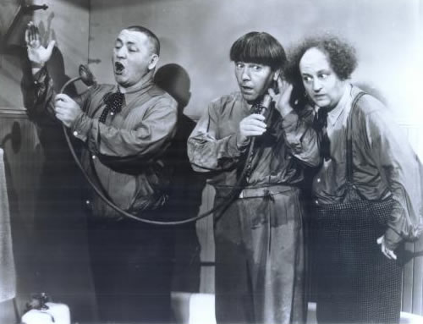
Asynchronous Code Difficulties
Hard to imagine when and what code runs
Hard to notify a component completed
So far, we used callbacks (JavaScript)

Slide 16
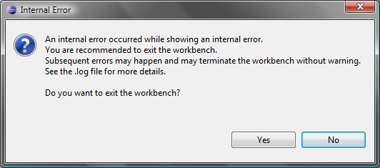

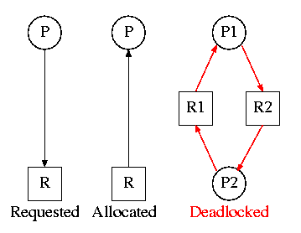
Asynchronous Programming Difficulties
Threads must wait for shared resources
Hard to synchronize resource access
Deadlocks can occur

Slide 17
Parallel Processing and Concurrency in .NET
Broad View on the Concurrency APIs

Slide 18
Parallelism APIs in .NET
.NET has introduced several concurrency approaches over the years
Managed Threading – low level
Asynchronous Programming Model (APM) – old
Event-based Asynchronous Pattern (EAP) – old
Task-based Asynchronous Pattern (TAP)
The recommended approach is TAP
It also integrates with new .NET language features
TAP roughly divides into
Data Parallelism
Task Parallelism

Slide 19
Data Parallelism
Using built-in concurrency from the TPL

Slide 20
Data Parallelism
Data Parallelism is the parallelization of loops
Tasks.Parallel supports several variations of:
Asynchronous For loops
Asynchronous ForEach loops
Keep in mind:
A parallel loop is still a blocking operation
The iterations are parallel inside the loop
But the loop isn’t parallel to the rest of the code

Slide 21
Simple Parallel For loop
static void MultiplyMatricesParallel(double[,] matA, double[,] matB,
double[,] result)
{
int matACols = matA.GetLength(1);
int matBCols = matB.GetLength(1);
int matARows = matA.GetLength(0);
Parallel.For(0, matARows, row =>
{
for (int col = 0; col < matBCols; col++)
{
double currentCellValue = 0;
for (int k = 0; k < matACols; k++)
currentCellValue += matA[row, k] * matB[k, col];
result[row, col] = currentCellValue;
}
});
}

Slide 22
Simple Parallel ForEach loop
Parallel.ForEach(filesInDirectory, currentFile =>
{
string filename = System.IO.Path.GetFileName(currentFile);
Console.WriteLine("Processing {0} on thread {1}", filename,
Thread.CurrentThread.ManagedThreadId);
System.Drawing.Bitmap bitmap = new System.Drawing.Bitmap(currentFile);
bitmap.RotateFlip(System.Drawing.RotateFlipType.Rotate180FlipNone);
bitmap.Save(System.IO.Path.Combine(targetDirectoryPath, filename));
});

Slide 23
Parallel.ForEach
Parallel.For
Live Demo

Slide 24
Exceptions in Parallel Loops
No built-in exception-handling behavior
Act similarly to normal loops
An exception ends the loop
However, normal loops execute sequentially
If the "last" iteration fails – all others passed
Parallel loops have no strict order of iterations
If a parallel loop fails one iteration, we don't know which other iterations executed

Slide 25
Exception Handling in Parallel Loops
Simplest case – you ignore partial execution
Discard results and run the thing again
Just wrap the loop in a try-catch
Just as for anything else you expect to throw
Don't forget to clean-up side-effects of failures
Note: you’re fishing for AggregateException
try {
squareRootsByInteger = ProcessSquareRootsParallel(integers.ToArray());
}
catch (AggregateException) {
Console.WriteLine(“Calculation failed, please retry");
}

Slide 26
Exception Handling in Parallel Loops
Often we want to know which iterations failed
Catch exceptions INSIDE the loop
Store them in a collection
Throw them in an AggregateException in the end
var exceptions = new ConcurrentQueue<FileFlipFailedException>();
Parallel.ForEach(filepathsToFlip,
(filepath) => {
try {
FlipImage(filepath, targetDirectoryPath);
} catch (Exception e) {
exceptions.Enqueue(new FileFlipFailedException(filepath, e));
}
});
if (!exceptions.IsEmpty) {
throw new AggregateException("One or more file process failed", exceptions);
}

Slide 27
Exception Handling in Parallel Loops
Live Demo

Slide 28
Parallel LINQ
Parallel LINQ operations can be done
PLINQ is an extension to LINQ to Objects
Not the same as LINQ to SQL!
Just call AsParallel() on the collection
The .NET Framework does the rest
(some exceptions^{[1][2]}, out of our scope now)
int[] nums = new int[] { 1, 2, 3, 4, 5 };
var evenNumsParallel = from num in nums.AsParallel()
where num % 2 == 0
select num;

Slide 29
Race Conditions 101, Locking & Interlocked Class
Protecting Against Race-Conditions in .NET

Slide 30
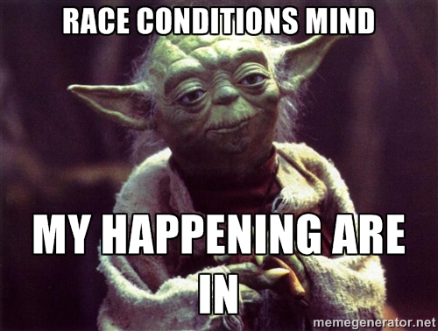
Race Conditions (in Software)
2 or more pieces of code executing in parallel:
Either execute in an improper order
Or modify the same data at the "same time", messing with each other’s results
Hard to catch – not deterministic
Because they depend on timing

Slide 31
Race Conditions Example
Some software computing the sum of sales at the end of the day
Doing it in a parallel loop to be “more efficient”
static DaySales AggregateDaySales(List<SoldItem> allSales)
{
var soldItemCounts = new Dictionary<string, int>();
int totalCents = 0;
Parallel.ForEach(allSales, (soldItem) => {
if (!soldItemCounts.ContainsKey(soldItem.Name))
soldItemCounts[soldItem.Name] = 1;
else
soldItemCounts[soldItem.Name]++;
totalCents += soldItem.PriceCents;
});
return new DaySales(totalCents, soldItemCounts);
}

Slide 32
Race Conditions
Live Demo

Slide 33
Races – Simple example
Race conditions are mostly some variation of the following:
Two threads want to increment a value
Each must read value and then write value + 1
Expected operations
Actual operations
Thread 1 | Thread 2 |  | Value
 |  |  | 0
Read value (0) |  | ← | 0
Increase (0+1) |  |  | 0
Write back (1) |  | → | 1
 | Read value (1) | ← | 1
 | Increase (1+1) |  | 1
 | Write back (2) | → | 2
Thread 1 | Thread 2 |  | Value
 |  |  | 0
Read value (0) |  | ← | 0
 | Read value (0) | ← | 0
Increase (0+1) |  |  | 1
 | Increase (0+1) |  | 1
Write back (1) |  | → | 1
 | Write back (1) | → | 1
Source: https://en.wikipedia.org/wiki/Race_condition#Example

Slide 34
Solving Race Conditions
Locking
Specifying a "key" for code blocks which are run by ONE thread at a time
Threads wait for the "key" to be "released" to enter a block with that "key"
Synchronization
Threads let each other know of their states
Can "signal" other threads about progress & suspend execution until a new signal

Slide 35

Locking in C#
C# provides the lock keyword and code block
Takes an argument of reference type
The argument is used as a "key" – code which wants to lock on the same key needs to wait until the key is released
lock (aggregationLock)
{
if (!soldItemCounts.ContainsKey(soldItem.Name))
{
soldItemCounts[soldItem.Name] = 1;
}
else
{
soldItemCounts[soldItem.Name]++;
}
totalCents += soldItem.PriceCents;
}

Slide 36
Using lock to Handle Races
Live Demo

Slide 37
Locking in C# - Warnings
Be careful – you are NOT "locking" the object itself
The object is just a "ticket" used to get access to code
Avoid locking on types/objects outside your control
Specifically AVOID:
lock(this) – if this is publicly accessible (it usually is)
lock(typeof(SomeClass)) – if SomeClass is publicly accessible
lock("someString") – string literals are accessible from anywhere
Deadlocks happen due to locking gone wrong:
Two or more threads lock and wait each other to unlock

Slide 38
Deadlocks
Live Demo

Slide 39
Locking in C# – Other Ways
Monitors – exactly the same as lock, only longer syntax
lock is shorthand for creating, Enter()ing & Exit()ing a monitor
Mutexes – similar to locks, but can be used across processes
Mutexes across processes use names
Can’t share code objects
Can be used for a single process
That's wasteful – use locks
Interlocked class
Built-in atomic compare, exchange, increment/decrement
E.g.: Interlocked.Add(ref totalCents, 1)
ReaderWriter locks – "smarter" locks
Blocking access when writing, but not blocking when reading

Slide 40
Concurrent Collections
The .NET Thread-Safe Wrappers Over Commonly Used Data Structures

Slide 41
Concurrent Collections
.NET 4 provides thread-safe wrappers for standard collections
The framework handles locking under the hood
Very useful to reduce complexity in your code
Just use as if not writing asynchronous code
Found in System.Collections.Concurrent
ConcurrentDictionary, ConcurrentBag
ConcurrentStack, ConcurrentQueue
Several interfaces, a Producer-Consumer pattern, etc. (Warning: some require .NET 4.5)

Slide 42
Task Parallelism (TAP)
The .NET 4.0 (and above) Approach to Parallel Operations

Slide 43
TAP
Async operations represented through Tasks
A task is "work" that will be done in the future
Running a task is NOT a blocking operation
Code which started the task continues on
The task executes separately
The task can report back when it’s done
The API manages threads
Thread execution, work reassignment, cleanup, optimizations, tread pools, etc.

Slide 44
Tasks
Notable stuff in a Task:
Code to execute (passed in as a delegate)
A Result, when it finishes
A Status indicating its execution status
Exception property, containing an AggregateException
The Tasks library is TPL (Task Parallel Library)

Slide 45
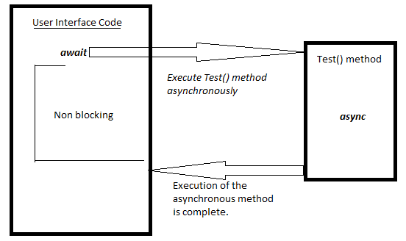
Fundamental Task Operations
Creating and Running
Continuing a task (i.e. attaching a chain of operations)
Handling Exceptions
Progress Reporting (optional)

Slide 46
Creating and Running Tasks
Several methods to create a task
Task constructor
Task.Run factory method
Tasks.TaskFactory factory class
Using Task constructor
Task is created, code to execute is provided
Task is not executed – user has to call .Start() method
Useful for detailed construction of the Task

Slide 47
Creating and Running Tasks (2)
Using Task.Run() static factory method
Receives a delegate to execute
Returns a new Task
The Task begins execution
Some customization parameters, but not much
TaskFactory approach
Allows a lot of Task customization
Scheduling, Grouping tasks, etc.

Slide 48
Running Tasks
In most cases, Task.Run() will be enough to get the task going
The runtime will handle the rest
public static Task<List<int>> RunPrimesInRangeAsync(
int rangeFirst,
int rangeLast)
{
return Task.Run(
() => PrimesInRange(rangeFirst, rangeLast)
); // .ContinueWith(…)
}

Slide 49
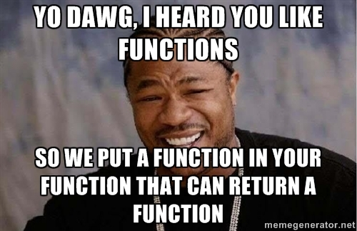
Getting Values from Tasks
The way in 4.0 – use a callback
Attaching callback to execute on completion: ContinueWith((completedTask) => {…})
You get the completed task as a parameter
Then take its Result
Avoid Result directly!
It blocks until the task completes

Slide 50
Continuing Tasks
Using ContinueWith()
Run Task & set callback with ContinueWith()
ContinueWith() will get the completed (or failed) task as a parameter
Use the Result property of the task – no longer blocking (the task finished)
RunPrimesInRangeTask(rangeFirst, rangeLast)
.ContinueWith((primesInRangeTask) =>
{
foreach (var prime in primesInRangeTask.Result)
{
Console.WriteLine(prime);
}
});

Slide 51
Creating and Continuing Tasks
Live Demo

Slide 52
Tasks Exception Handling
Task.IsFaulted – indicates if the task encountered an exception
The exception is stored in an AggregateException in the Task
The Exception property provides it
static void LoadSqrtTable(string filename,
ConcurrentDictionary<int, double> table)
{
RunReadSquareRootsLookupTableTask(filename).ContinueWith((loadTask) =>
{
if (loadTask.IsFaulted)
Console.WriteLine("Failed to load due to: " + loadTask.Exception);
foreach (var entry in loadTask.Result)
table[entry.Key] = entry.Value;
});
}

Slide 53
Tasks Exception Handling
Live Demo

Slide 54
Callback Problems
Code becomes hard to track
Exceptions are not propagated properly
Thread context is not saved
i.e. a callback defined in one thread is not guaranteed to work on same thread
(unless explicitly specified, but this could get messy – what if you have nesting?)

Slide 55
Callback Problems : Example
UI thread attaches a callback to a calculation
Callback should print results in a ListView
Calculation completes -> callback is run
But not on UI thread
The callback has no access to the UI thread's resources and we get a "wrong thread" exception
In WPF and UWP use a Dispatcher for working with the UI

Slide 56
Tasks with async & await
The C# 5 approach to asynchronous programming

Slide 57
Tasks with async & await
Tasks + async & await = modern approach
Tasks can be "awaited"
Methods can be marked as asynchronous
async and await keywords
Make sense when used together
Enable "inline" multithreaded code
Remove callbacks from code ("flatten")
Code looks like normal sync code
Compiler generates appropriate callbacks

Slide 58
The async keyword
Used on a method signature
Marks a method, which CAN be asynchronous
Does NOT make it asynchronous – you do, through an await
Return type must be void, Task or Task<T>
Return value is automatically wrapped
Means "could wait for a resource/operation"
If it starts waiting, return to the calling method
When the wait is over, go back to called method

Slide 59
The await keyword
Used in a method which has async keyword
Saves the context in a state machine
Marks waiting for a resource
Resource should be a Task
Unwraps T result from Task<T>, on completion
Means "await the completion of a task"
While awaiting -> let the rest of the code run
Awaiting over -> continue executing the next statements in the method

Slide 60
Tasks Without async & await
Remember this? Not pretty, right?
void LoadSqrtTable(string filename,
ConcurrentDictionary<int, double> table)
{
RunReadSquareRootsLookupTableTask(filename)
.ContinueWith(
(loadTask) =>
{
foreach (var entry in loadTask.Result)
{
table[entry.Key] = entry.Value;
}
});
// Note: you might need this in applications,
// in which you need to populate data in the UI,
// meaning you have to run in the UI thread's context
/*, TaskScheduler.FromCurrentSynchronizationContext() */
}

Slide 61
Tasks with async & await
How about now?
Looks like normal code, but actually works asynchronously, analogous to the previous example
static async void LoadSqrtTable(string filename,
ConcurrentDictionary<int, double> table)
{
var sourceTable = await ReadSquareRootsLookupTableAsync(filename);
foreach (var entry in sourceTable)
{
destinationTable[entry.Key] = entry.Value;
}
}

Slide 62
Exceptions with async & await
Exceptions are propagated up to the await-er
We can now handle exceptions at the proper level in the method hierarchy
Warning: async methods should handle all exceptions after await
static async void LoadSqrtTable(string filename,
ConcurrentDictionary<int, double> table)
{
try {
Dictionary<int, double> source =
await ReadSquareRootsLookupTableAsync(filename);
foreach (var entry in source)
table[entry.Key] = entry.Value;
} catch (FormatException) {
Console.WriteLine("Lookup table was in a bad format.");
}
}

Slide 63
Using Tasks with async & await
Live Demo

Slide 64
Asynchronous Programming in C#
http://academy.telerik.com

Slide 65




Free Trainings @ Telerik Academy
C# Programming @ Telerik Academy
csharpfundamentals.telerik.com
Telerik Software Academy
academy.telerik.com
Telerik Academy @ Facebook
facebook.com/TelerikAcademy
Telerik Software Academy Forums
forums.academy.telerik.com

